Slide 1
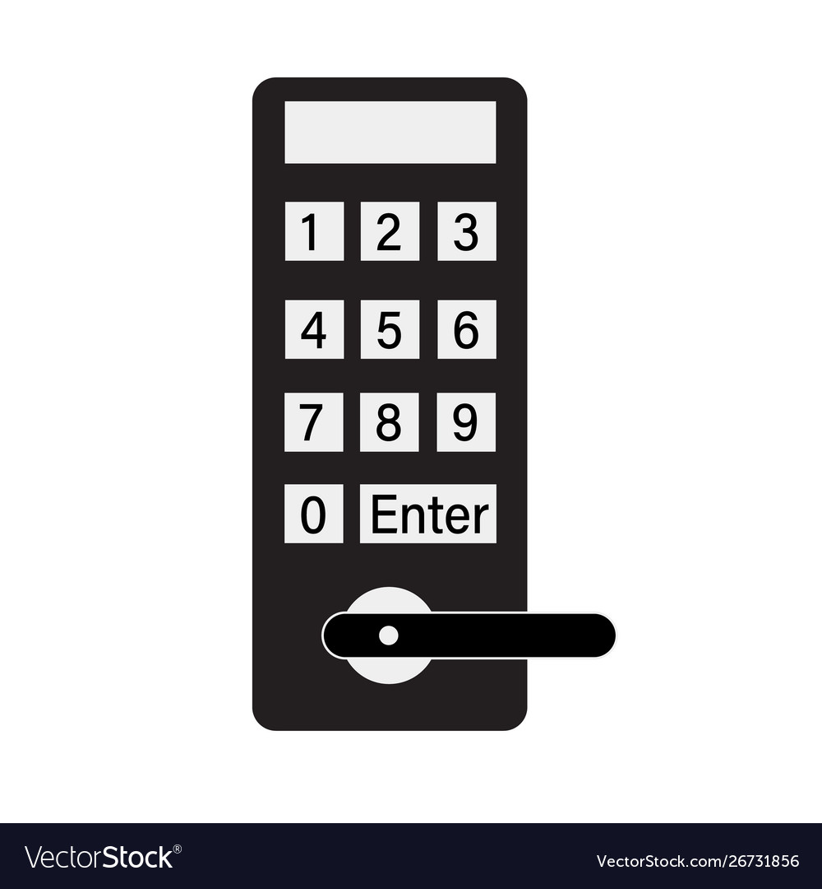
Door Lock/Unlock Using Raspberry Pi 4

Slide 2
Team members
Younus Hazım Hasan 1810206527@ogrenci.karabuk.edu.tr
Yiğit Koçtürk 2017010206045@ogrenci.karabuk.edu.tr
Sinan Baykan 1910206067@ogrenci.karabuk.edu.tr
Ali Alrazouk 18102060196@ogrenci.karabuk.edu.tr
Kaan Uluhan 2017010206023@ogrenci.karabuk.edu.tr
Melih Kılıç 2017010206063@ogrenci.karabuk.edu.tr
Ismayıl Maharramov 2017710206175@ogrenci.karabuk.edu.tr
Keremcan Düşünür 2017010206059@ogrenci.karabuk.edu.tr

Slide 3

Introduction
Houses have different security systems such as exterior doors and interior doors. Different lock systems can be used on all doors to provide special security for the areas.
We made a similar system by using Raspberry PI4. Our project, in short, is a door connected to a lock connected to a motor that opens the door when the password is entered correctly.
The main objective is to show the type of door lock protection and its importance

Slide 4
Distribution Of Tasks
Software process
Design Process
Younus Hazım Hasan
Sinan Baykan
Yiğit Koçtürk
Melih Kılıç
Keremcan Düşünür
Ali Alrazouk
Kaan Uluhan
Ismayıl Maharramov

Slide 5

Project work plan:
Project design plan
Getting all the hardware products for the project .
Starting the programming process
Test all pieces and connect them together
Final assembly process

Slide 6
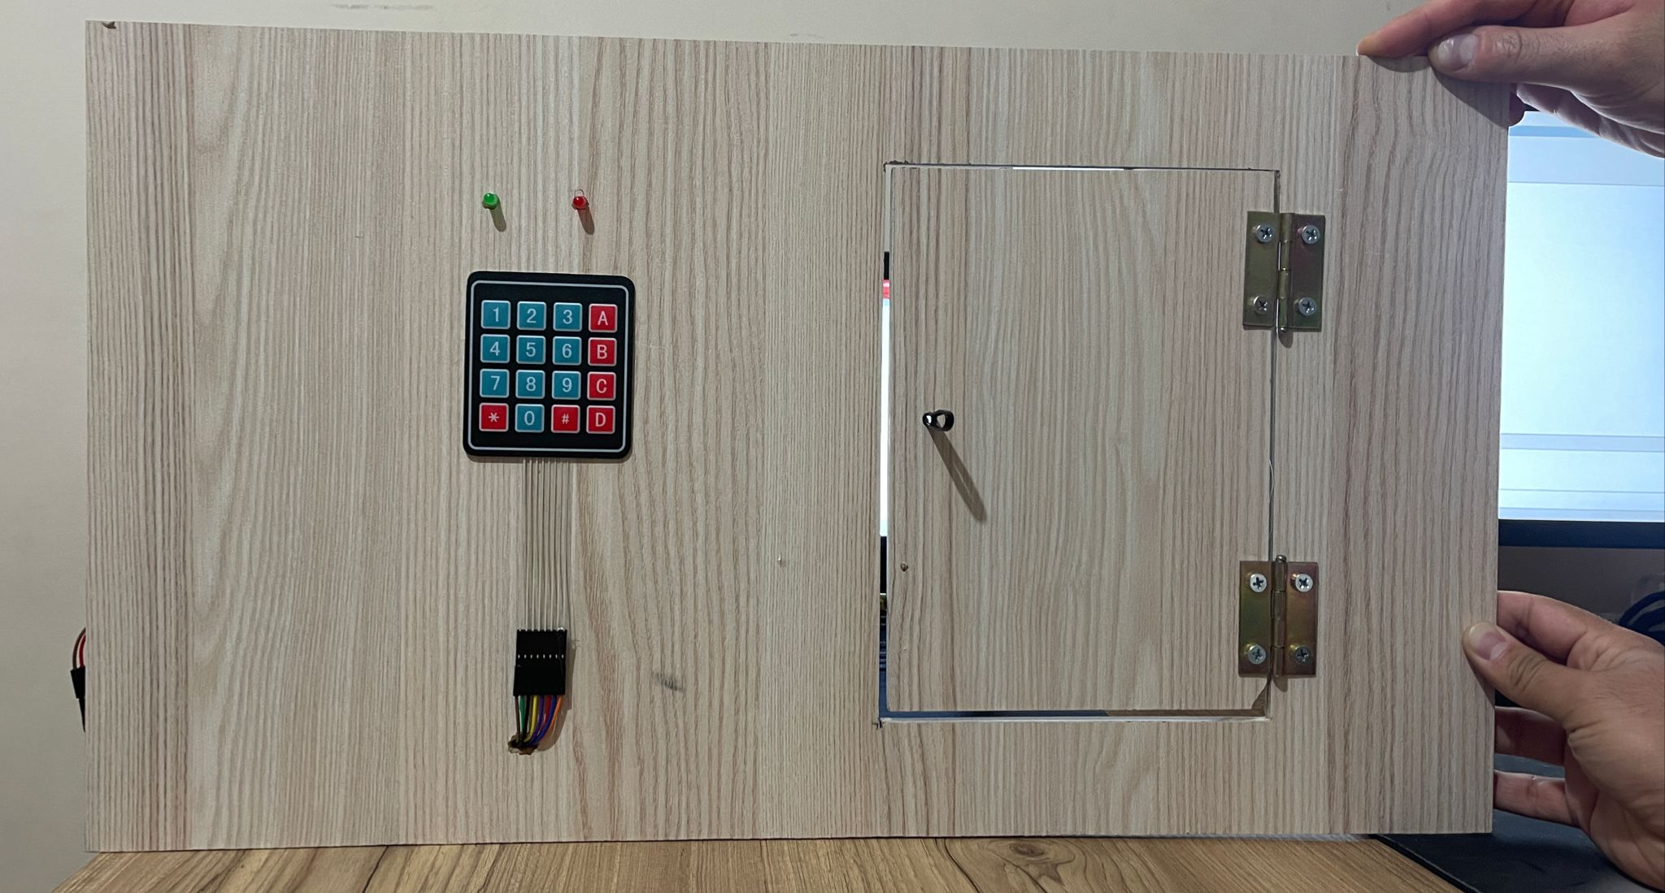
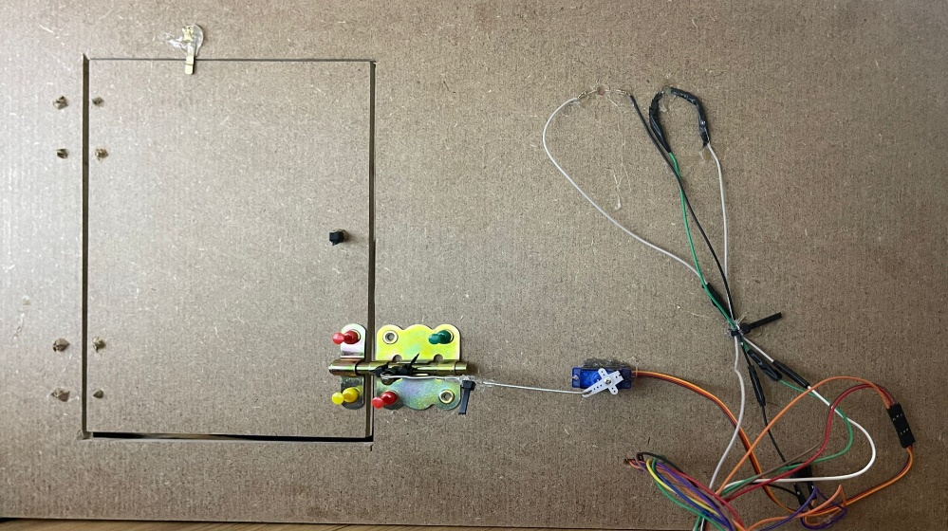
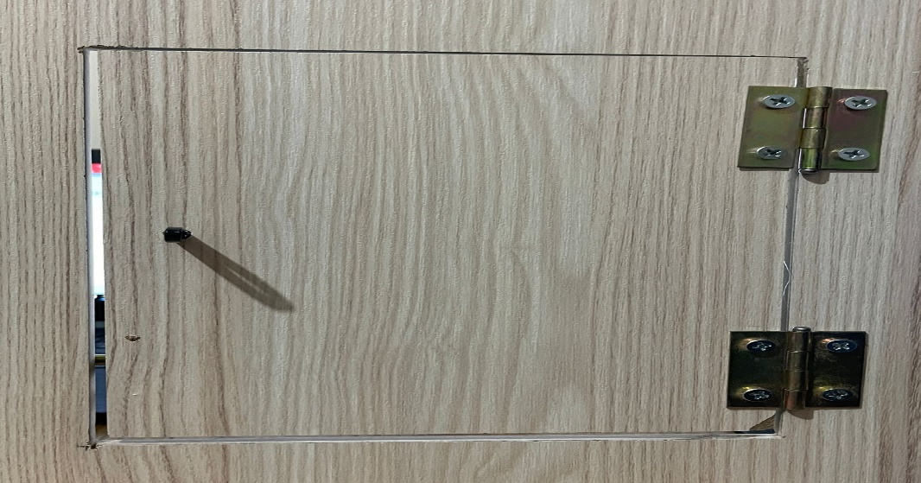
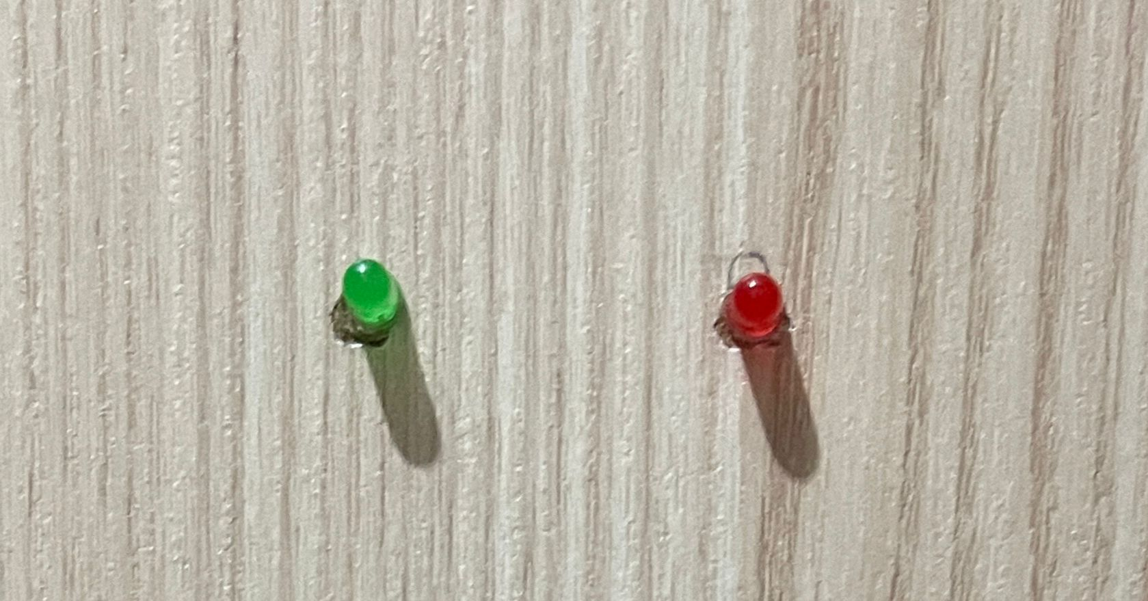
Pictures of the finished project and used parts

Slide 7
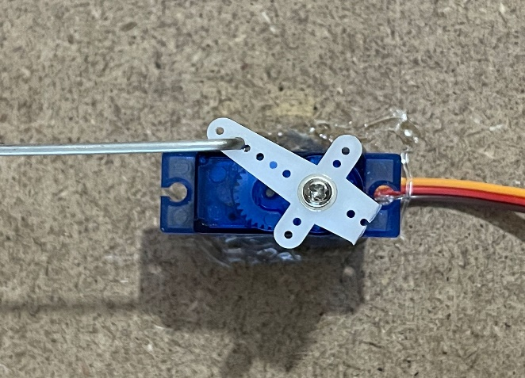
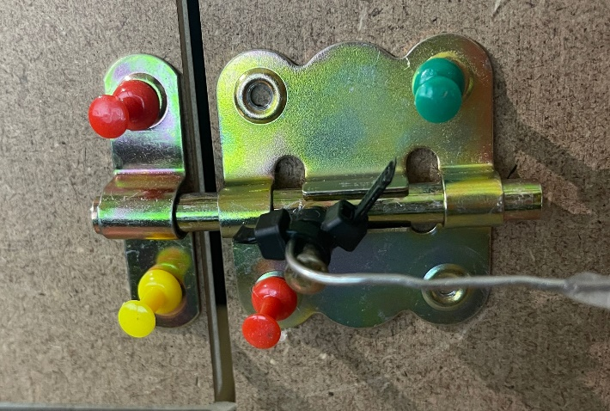
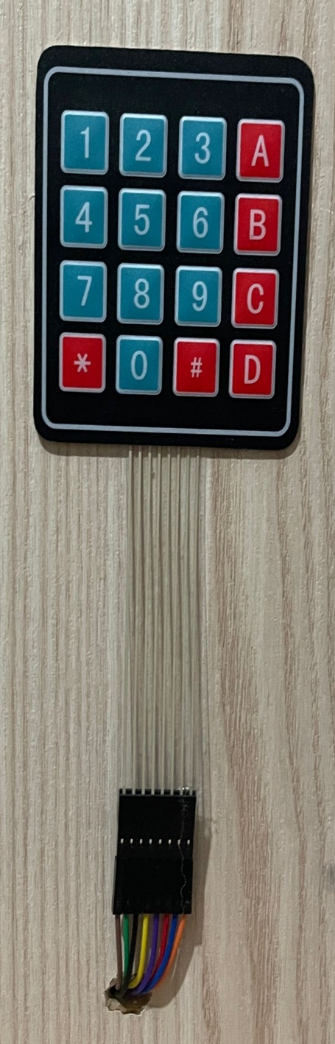
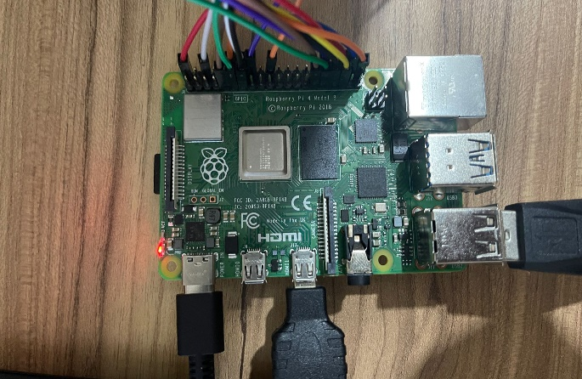
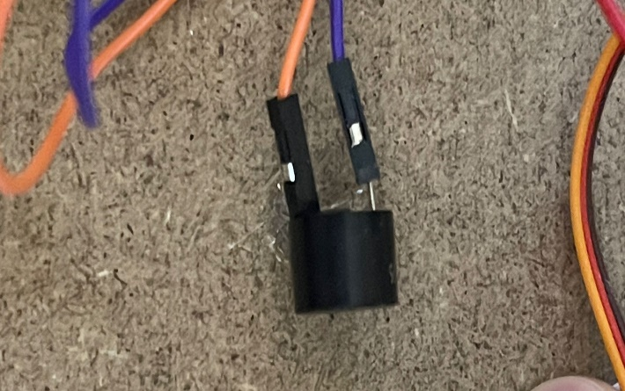
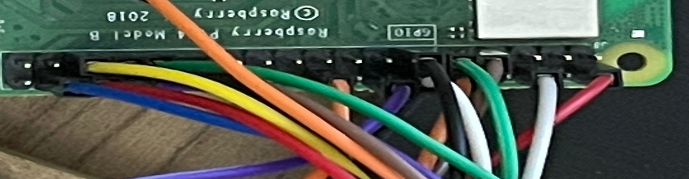

Slide 8
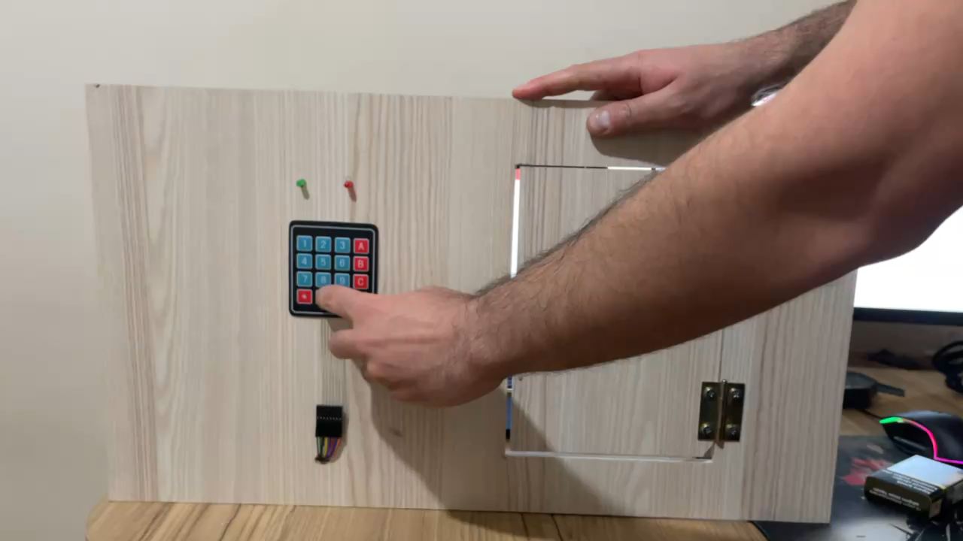
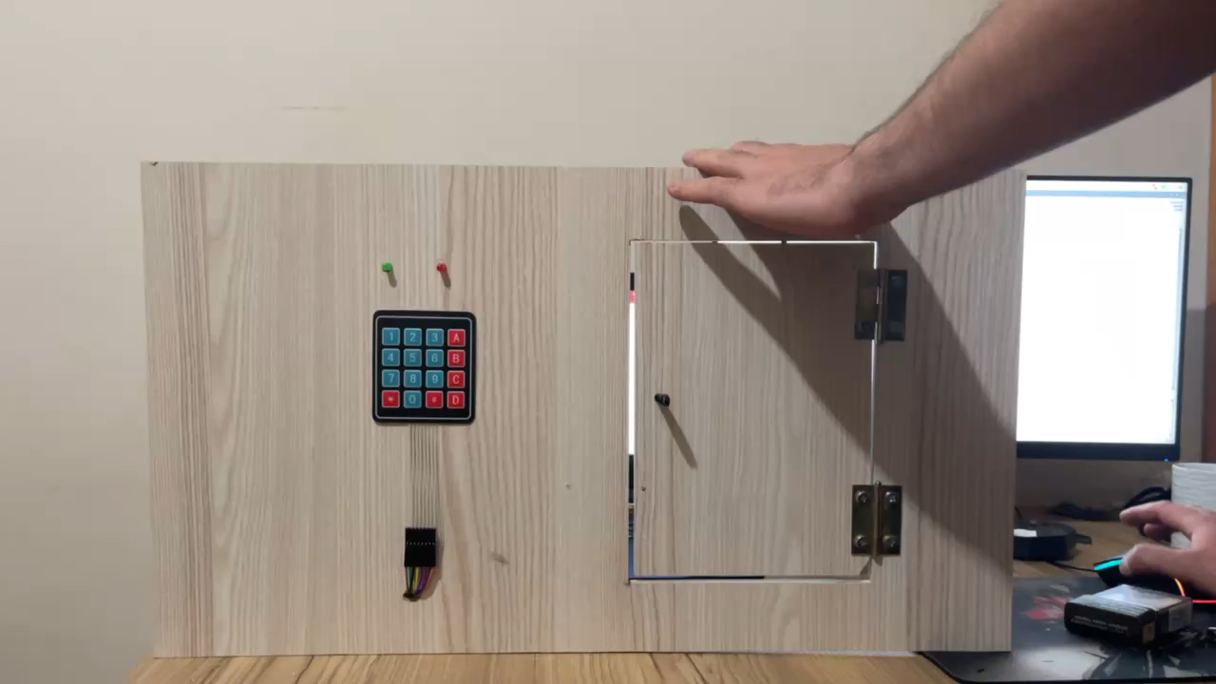
Videos showing how the project works:
Password is correct
Password is not correct

Slide 9
Names of the parts used in the project (hardware):
Raspberry PI 4
Servo Motor
Keypad
Buzzer
Led
Cables
Slide Lock
Wooden board
Hinges

Slide 10
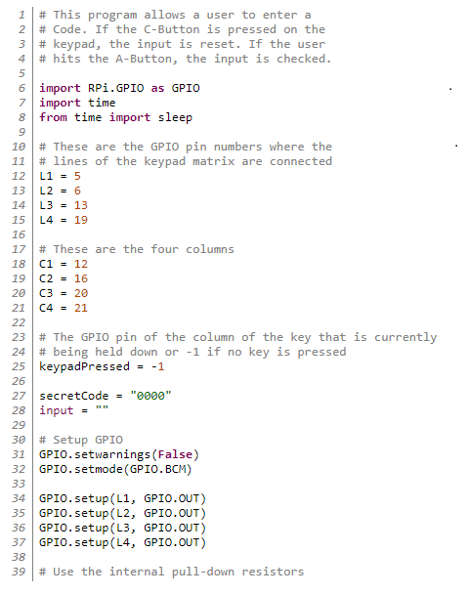


Slide 11

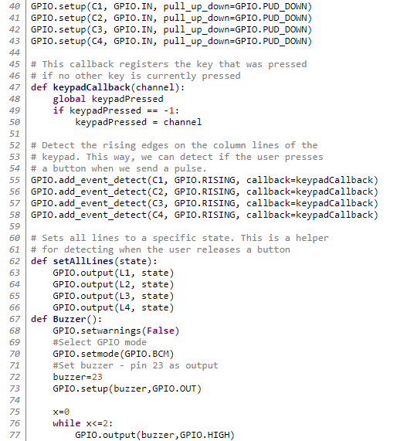

Slide 12
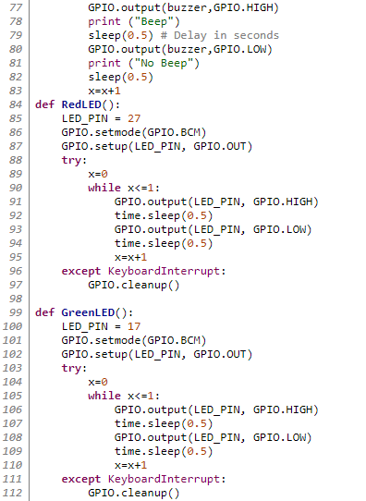

Slide 13
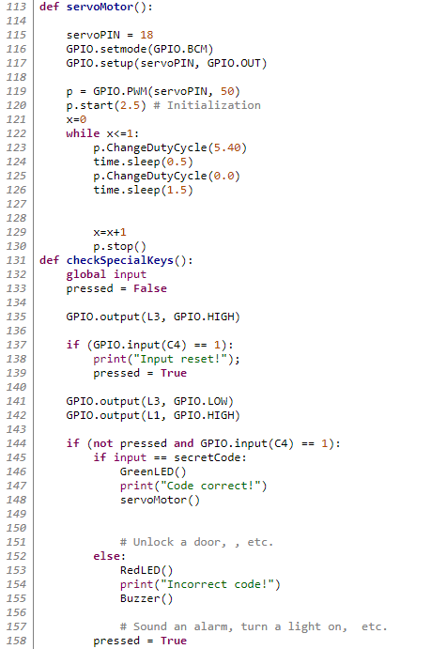

Slide 14

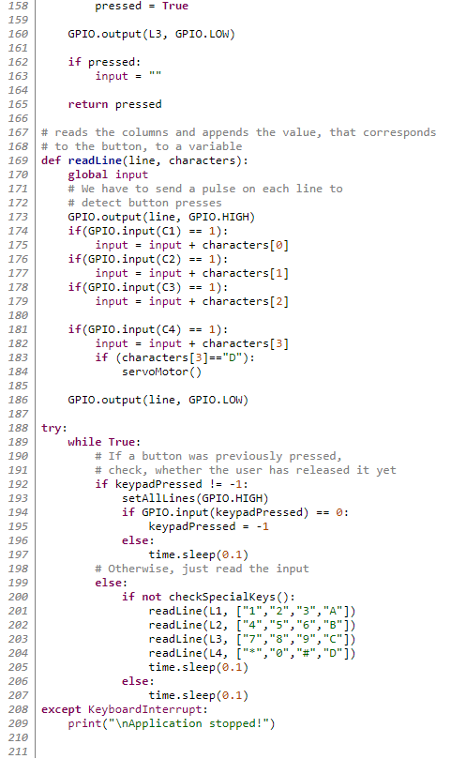

Slide 15


Conclusion
In summary, the project clarifies the basic idea of gaining more privacy and safety in our lives. We expected that the project would be better than this, but because it is our automatic experience in this field and the lack of suitable parts for better implementation, we have done what we can, for us the most important thing is to acquire Experience in this field.

Slide 16
Thank You For Your Attention

